Slide 1

Daria Solodey
Methodologist, course creator, English teacher

Slide 2

🔥
Our goal
Pass a job interview
Our rules:
Turn on your camera
Set up your microphone
Be active
Notes:
Если вам не хватило места, вы можете здесь написать развернутый комментарий.

Slide 3




Read the sentences and phrases. What do they have in common?
How do you keep yourself motivated?
Do you read any inspiring literature / blogs?
Notes:
Optional: Which picture would you use as a wallpaper?

Slide 4

Lesson Plan:
Discuss what confidence is and why it’s important
Study tips to become more confident
Answer the question:
What are your career development goals?
Notes:
Развернутый комментарий.

Slide 5

Which of the heads in the picture represents growth mindset and which represents fixed mindset? What is the difference between them?
Do you have a growth mindset? What makes you think so?
Do you perceive your mistakes as failures or setbacks?
Are all people with high self-esteem confident?
Are you a confident person?
What is confidence for you?

Slide 6

Watch the first part of the video and answer the questions.
What is "confidence"?
Where does it come from?

Slide 7
Answer the questions.
Confidence is…
Self-esteem + optimism + acting courageously
Confidence comes from…
- genes
- environment
- your choices
Which one affected your personality the most?

Slide 8
Watch the second part of the video and answer the question.
What quick-fix tricks are suggested in the video?

Slide 9
What quick-fix tricks are suggested in the video?
picture your success
pep talk
listening to the music with a deep bass
strike a powerful pose
Which of these tricks do you use?
Do you have any other tips?

Slide 10
Watch the last part of the video.
Do you give up quickly?
Do you believe in your ability to improve?
Which tip do you find the most useful?

Slide 11

How can you demonstrate your confidence at the interview?
What career prospects do you have after you finish the course?
What do you need to do to make them possible?

Slide 12
Read the answer to the question “What are your career goals?
Is it a good answer? How can you improve it?
EXAMPLE
I want to become a proficient fullstack developer and start working with new frameworks. Also, I additionally want to get new skills and improve my knowledge. I am eager to become a great professional and earn good money.
I really want to get this job!!

Slide 13
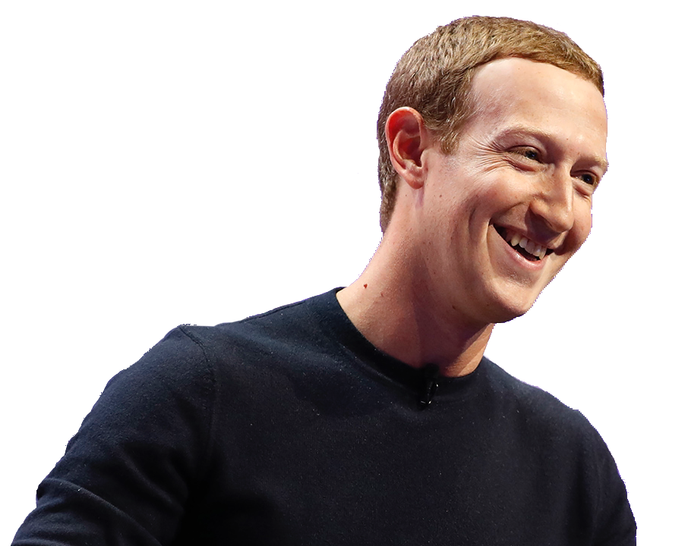
Look at a good answer. What has changed? Is it different from your career goals?
EXAMPLE
Hey, what are your career goals?
I want to become a proficient fullstack developer and start working with React. Also, I additionally want to study Vue.js, TypeScript, ReactNative. After I get a half-year or year work experience with frontend, I am eager to learn more about backend technologies and start with Node.js. I am hopeful that it would present me with new opportunities in this field.

Slide 14
Imagine that you are in a job interview with Mark Zuckerberg and he is asking you the question. What is your answer?
Tips:
choose 1-2 main goals
describe in detail how you will achieve them
be realistic and specific
Hey, what are your career goals?
This year I am going to master… (front-end development)
That’s why I have to get practical experience in… (React, Vue.js)
And then, I am planning to advance my career as… (a fullstack developer)
In a year, I want to start working with… (Node.js)

Slide 15
Homework
Answer the interview question What are your career goals?
(see pr. slides) and send to your teacher for proofreading
Revise the glossary and presentation for this lesson
Find out more about:
Six behaviors to increase your confidence | Emily Jaenson | TEDxReno

Slide 16
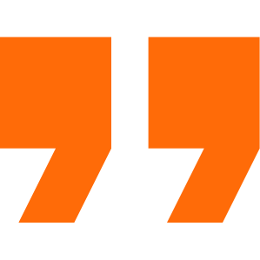
What have you learnt this lesson?
I learned:
What is confidence and why it’s important
Tips to become more confident
How to answer the question:
What are your career development goals?
Notes:
Развернутый комментарий

Slide 17
Useful links:
Video:
3 tips to boost your confidence - TED-Ed

Slide 18
Thank you!

